Slide 1
Data Marts

Slide 2
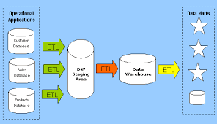
Data Mart

Slide 3
What is Data Mart?
The data mart is a subset of the data warehouse that is usually oriented to a specific business line or team.
Data marts are small slices of the data warehouse.
Whereas data warehouses have an enterprise-wide depth, the information in data marts pertains to a single department

Slide 4
Advantages of Data Mart
In some deployments, each department or business unit is considered the owner of its data mart including all the hardware, software and data.
This enables each department to use, manipulate and develop their data any way they see fit; without altering information inside other data marts or the data warehouse.

Slide 5
Data Warehouse Vs. Data Mart
Data warehouse:
  Holds multiple subject areas
  Holds very detailed information
  Works to integrate all data sources
  Does not necessarily use a dimensional model but feeds dimensional models.
Data mart:
  Often holds only one subject area - for example, Finance, or Sales
  Concentrates on integrating information from a given subject area or set of source systems
  Is built focused on a dimensional model using a star schema.

